Slide 1
Dynamic Incremental Loading ADF Pipeline

Slide 2
Migration of data from the SQL to Azure ADLS Container

Slide 3
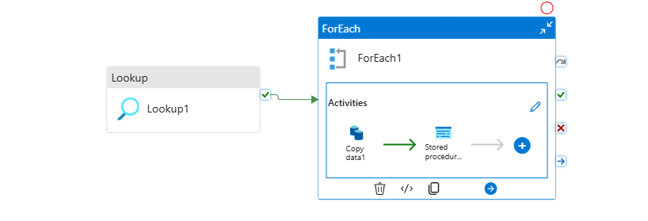

Slide 4
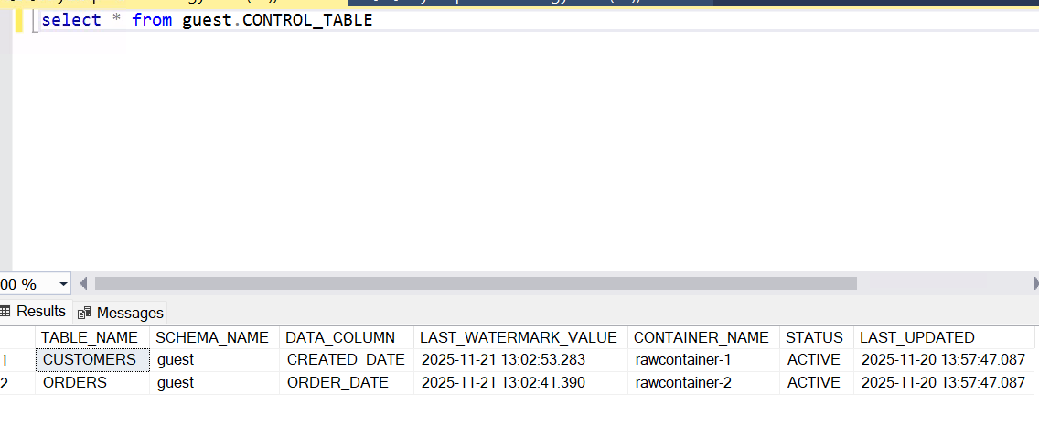
Meta data Table

Slide 5
Lookup activity
we are going with the to look data from metadata table.
SELECT * FROM guest.CONTROL_TABLE WHERE STATUS = 'ACTIVE’
For Each Loop:
Iterates over each row from Lookup output.
Inside For Each loop:
Copy Activity:
Logic checks for the Lastwatermark available on the and source Query
select * from @{item().SCHEMA_NAME}.@{item().TABLE_NAME} where @{item().DATA_COLUMN} > '@{item().LAST_WATERMARK_VALUE}’
Loads only the records based where Datacolumn is greater than the Lastwatermark_value

Slide 6
Stored Procedure:
Stored procedure will update the Control table watermarkcolumn only if the Copy activity "rowsRead“ matches with "rowsCopied“. And I will update the Audit table as well as the pipeline details for execution and auditing purposes.
Target (Azure blob container):
Incremental data files will be loaded into target on the incremental data.

Slide 7
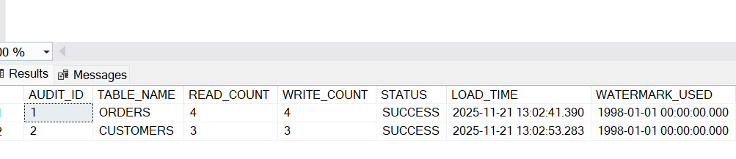
Audit Table

Slide 8
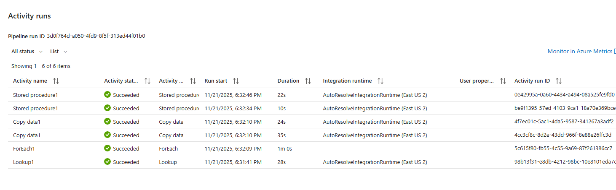

Slide 9
Conslusion:
Data is dynamically loaded incremental data from all the tables from the source systems to the target: external stage Azure container with the help of control tables.

